Slide 1
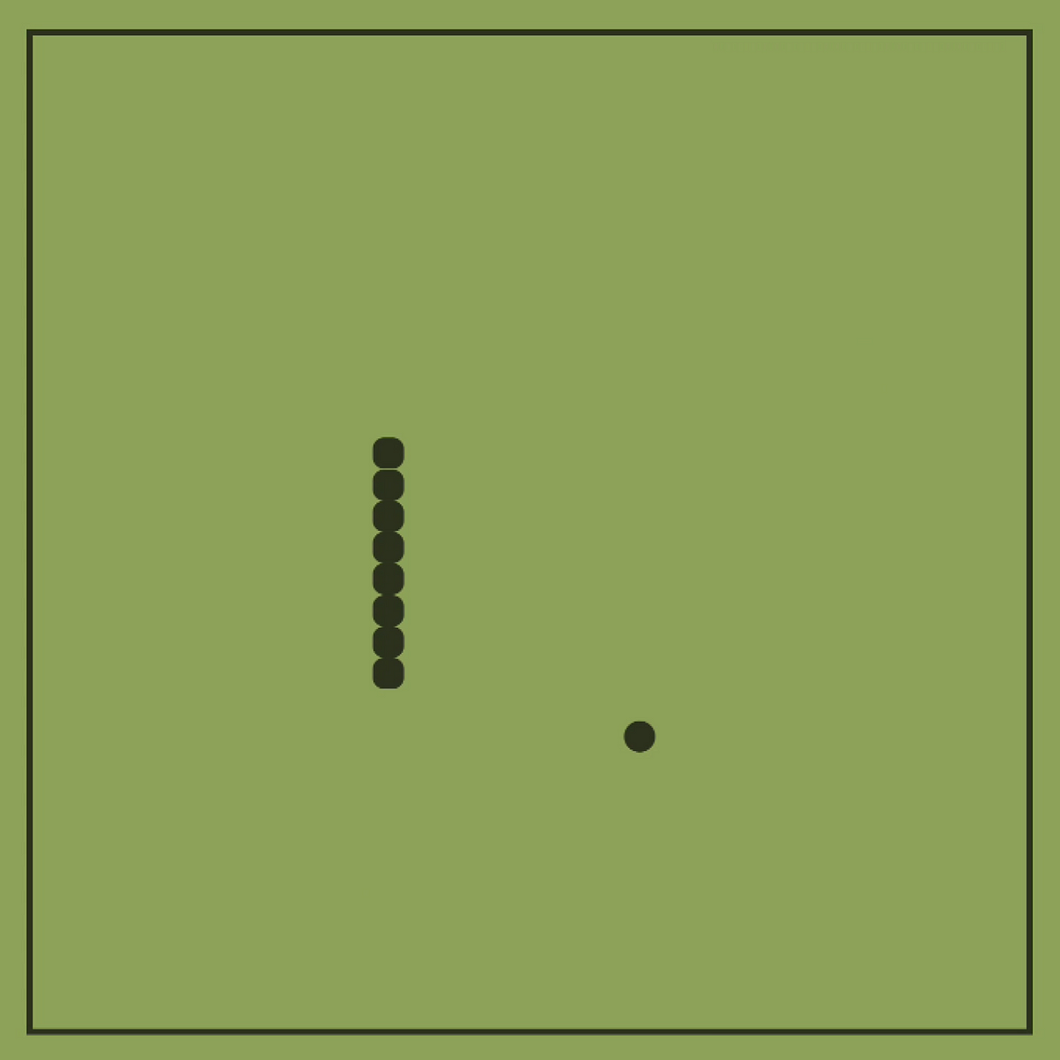
Snake game using Reinforcement Learning
Presented by:
Prudhviraj Boddu
Mahesh Gundagoni
Maniteja Bonagani

Slide 2
Snake game
We all know it’s a classical game from our childhood which was available on keypad phones.
It’s an arcade game, in which player tries to increase the score by having more food with the snake by moving keys without any collison.
We have python code which can play snake game, where we can interact with the game by ourselves.

Slide 4
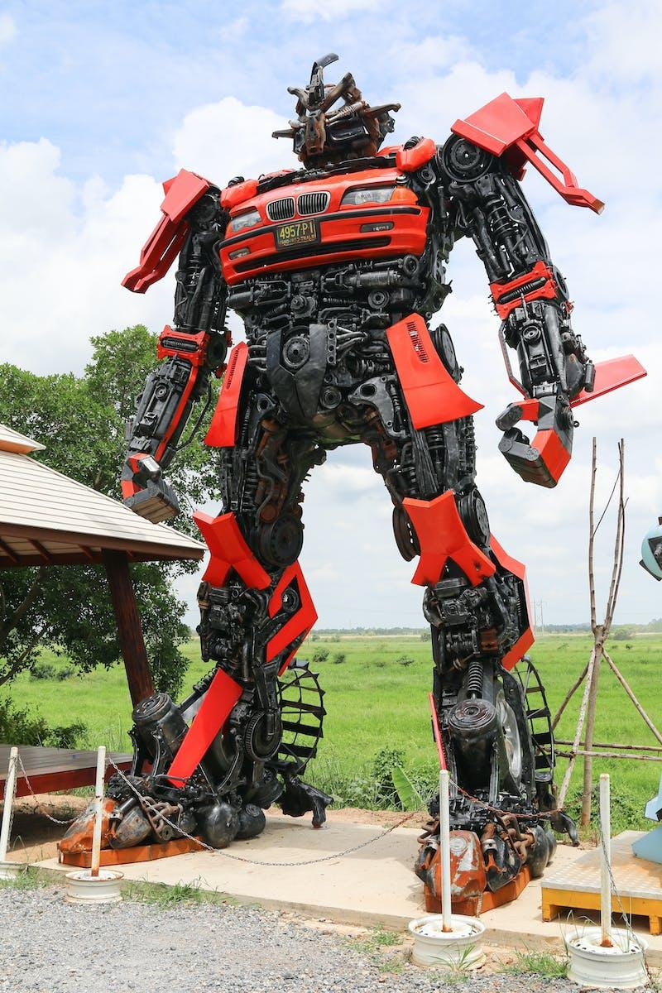
Introduction to Reinforcement Learning
Reinforcement learning is a type of machine learning that enables an agent to learn in an environment by trial and error using feedback from its own actions and experiences.
In RL, there are two components, that are environment( which is our game) and the agent (snake which is in the environment).
Every time the agent performs an action, the environment gives a reward to the agent, which can be positive or negative depending on how good the action was from that specific state.
Photo by Pexels

Slide 5
Snake Game Environment
We are defining the mechanics of the game such as grid’s size, the starting position of the snake which is half of height and width of the grid size, and the rules for generating food.
We are defining the game’s environment in game.py file, and we are defining the rules to move the agent around the environment that is to move either left,right,up or down.
Placing the food in the environment once it’s consumed the old food.
If there is any collision occurring to any of the grid boundaries or hitting itself.
Also playing the step which is gathering input from the user which can be either from RL agent or human, to move the snake along the grid.
Photo by Pexels

Slide 6
Deep Neural Network for Training
We are training a Deep Neural Network model using pytorch deep learning framework for our project.
It consists of 11 input layers with 256 neurons which are hidden, and output size is 3 layers.
The network receives as input the state, and returns as output three values related to the three actions: move left, move right, move straight( which can be up and down).
We are using RELU activation function for the last layer of the neural network.
Once the network is trained, we are saving the model in the same directory as the python file.
Photo by Pexels

Slide 7
Q-Learning Algorithm
We are using Q-learning, which is a popular reinforcement learning algorithm used for environments with discrete state and action spaces.
The algorithm uses the Q-value function, which estimates the expected cumulative reward for taking an action in a given state and following the optimal policy thereafter.
The Q-value function is updated iteratively based on the observed rewards and transitions.
Steps:
Initialize the Q-value function randomly for all state-action pairs.
Repeat until convergence or a maximum number of episodes:
Observe the current states.
Select an action a based on an epsilon-greedy policy.
Take the action a and observe the reward r and the next state s'.
Update the Q-value function.
Set the current state to next state s’.
Return the learned Q-value function.
Photo by Harpreet Singh Grewal on Unsplash

Slide 8
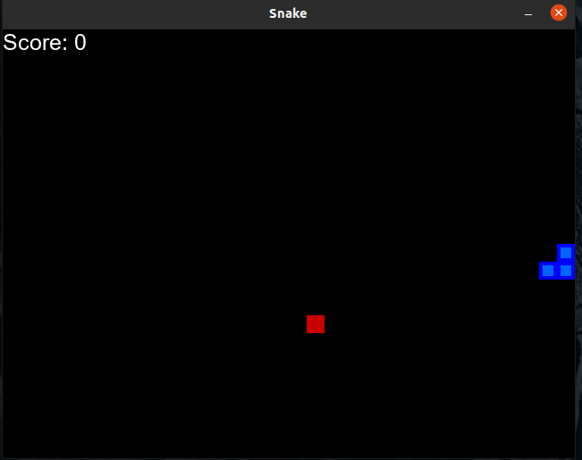
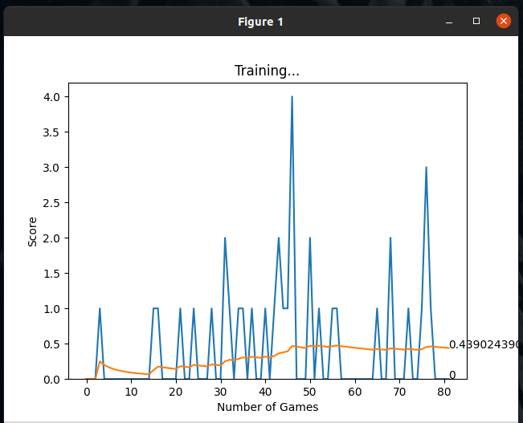
Implementing the AI and Neural Network
We used pygame module, which is a cross-platform set of Python modules designed for writing video games, which was used for rendering graphics, handling sound, and managing user interface elements such as windows, buttons, and input devices.
Project consists of 4 files to run the game,
in which game.py is an important file consists of the game environment.
model.py consists of Deep Learning code of q-trainer and Linear neural network.
agent.py which integrates both files to run the game.
helper.py which plots the results of training of the neural network using matplotlib.
Photo by Pexels

Slide 9
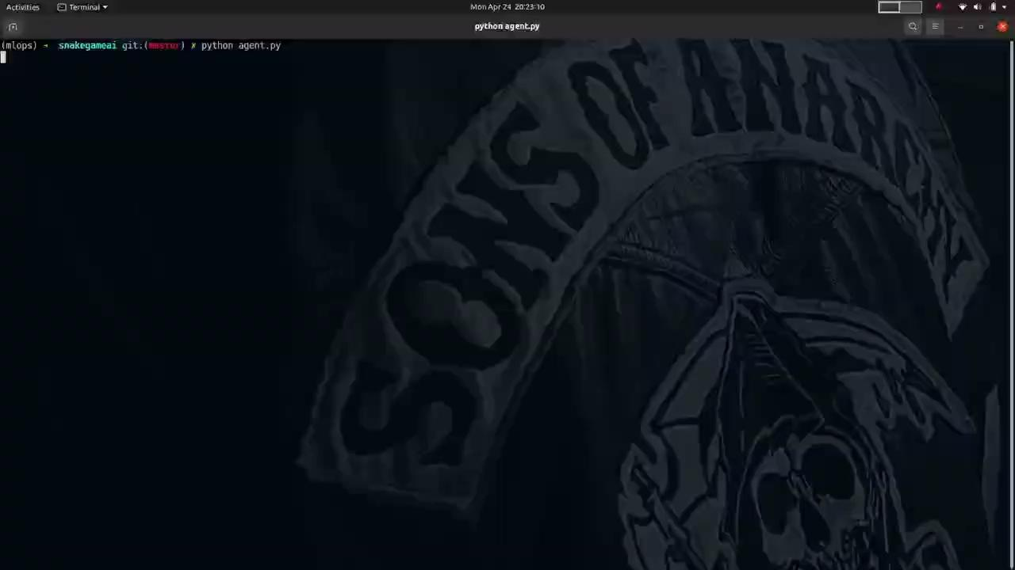
Game using AI
Photo by Pexels

Slide 10
Link to Code : https://github.com/prudhvirajboddu/snakegameai
Link to Presentation: https://www.youtube.com/watch?v=R7BtGHMlSW0
References: https://docs.replit.com/tutorials/python/build-snake-with-pygame

Slide 11
Thank You

